Slide 1



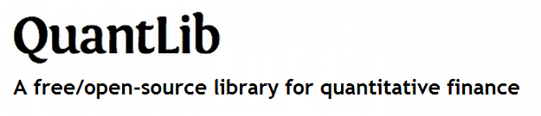
The abcd of Interest Rate Basis Spreads
Ferdinando M. Ametrano
ferdinando@ametrano.net
Luigi Ballabio
luigi.ballabio@gmail.com
Paolo Mazzocchi
mazzocchip@live.it
QuantLib User Meeting, London, July 12, 2016

Slide 2
Table of Contents
Rate Curves: Recent Developments and Current Practice
Rationale for ABCD Smooth Basis Modeling
Relation Between Continuous and Simple Basis
Tenor Dominance
Conclusions
Appendices
Estimation of First Pillar
Derivation of Equivalence Formulas

Slide 3
Multi-curve

Slide 4
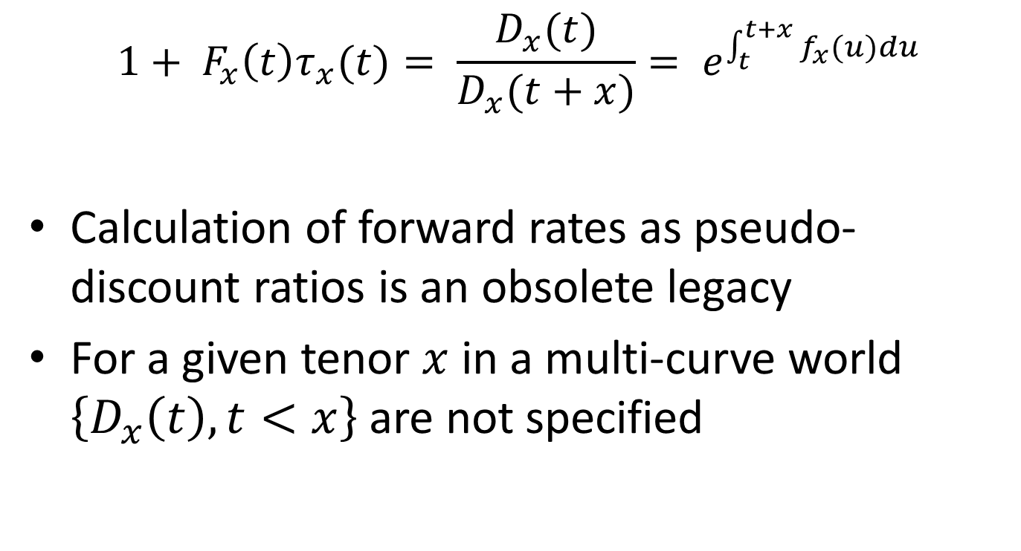
Forward Rates and Pseudo-Discounts
$$1+ F_{x}\left(t\right)τ_{x}(t)= \frac{D_{x}(t)}{D_{x}(t+x)}= e^{\int_{t}^{t+x}{f_{x}(u)du}}$$
Calculation of forward rates as pseudo-discount ratios is an obsolete legacy
For a given tenor $x$ in a multi-curve world $\left\{D_{x}\left(t\right), t<x\right\}$ are not specified

Slide 5
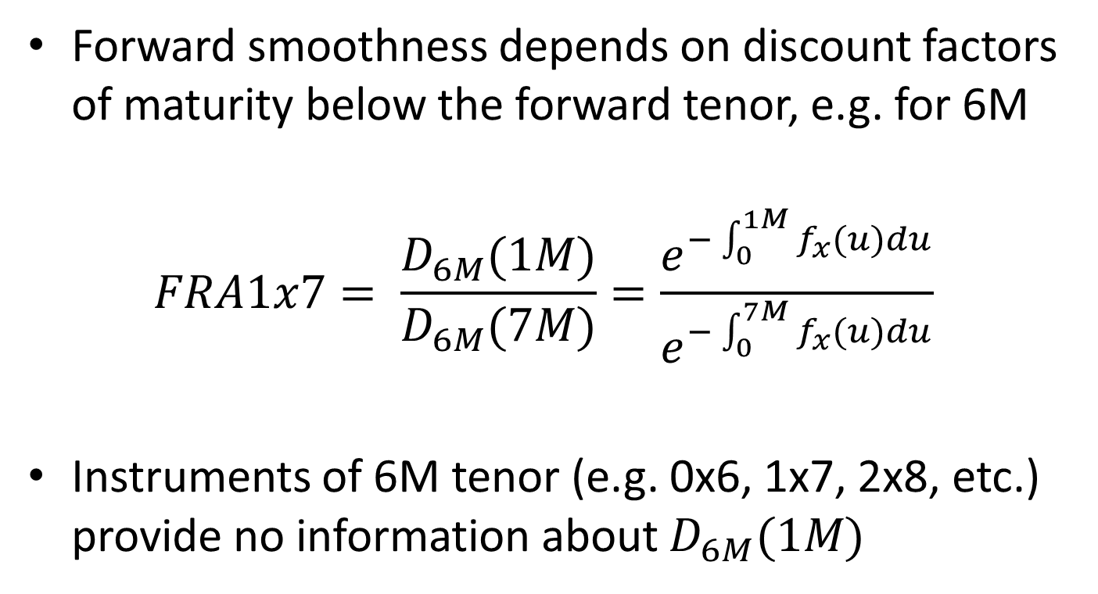
The Problem with Pseudo-Discounts
Forward smoothness depends on discount factors of maturity below the forward tenor, e.g. for 6M
$$FRA1x7= \frac{D_{6M}(1M)}{D_{6M}(7M)}=\frac{e^{−\int_{0}^{1M}{f_{x}(u)du}}}{e^{−\int_{0}^{7M}{f_{x}(u)du}}}$$
Instruments of 6M tenor (e.g. 0x6, 1x7, 2x8, etc.) provide no information about $D_{6M}(1M)$

Slide 6
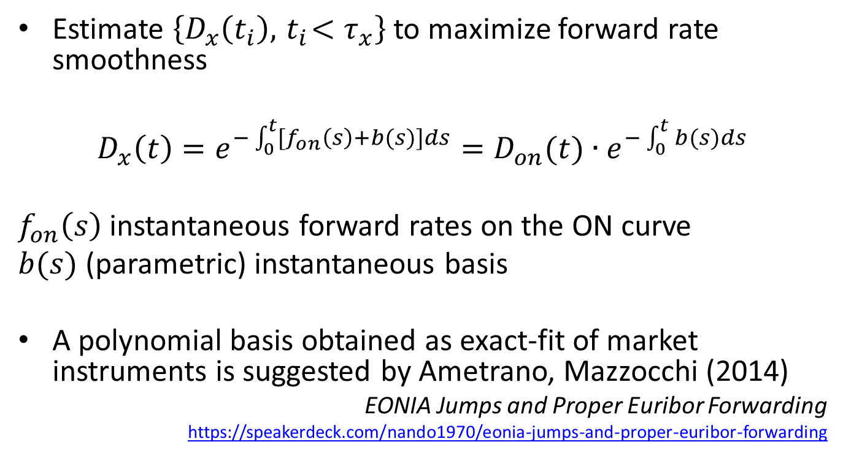
Synthetic Deposits Patch
Estimate $\left\{D_{x}\left(t_{i}\right),{ t}_{i}<τ_{x}\right\}$ to maximize forward rate smoothness
$$D_{x}\left(t\right)=e^{−\int_{0}^{t}{{[f}_{on}\left(s\right)+b(s)]ds}}=D_{on}(t){∙e}^{−\int_{0}^{t}{b(s)ds}}$$
$f_{on}\left(s\right)$ instantaneous forward rates on the ON curve
$b(s)$ (parametric) instantaneous basis
A polynomial basis obtained as exact-fit of market instruments is suggested by Ametrano, Mazzocchi (2014)
EONIA Jumps and Proper Euribor Forwarding
https://speakerdeck.com/nando1970/eonia-jumps-and-proper-euribor-forwarding

Slide 7
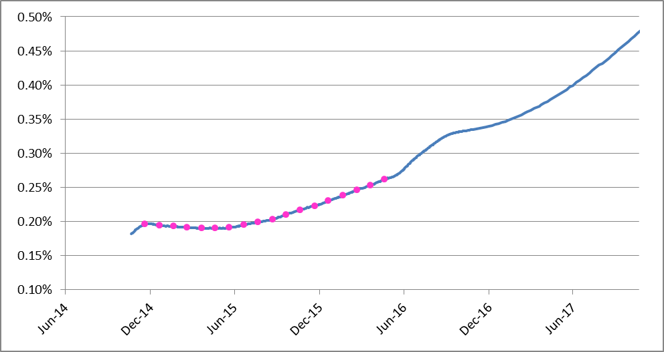
Pseudo-Discount World: EUR6M

Slide 8
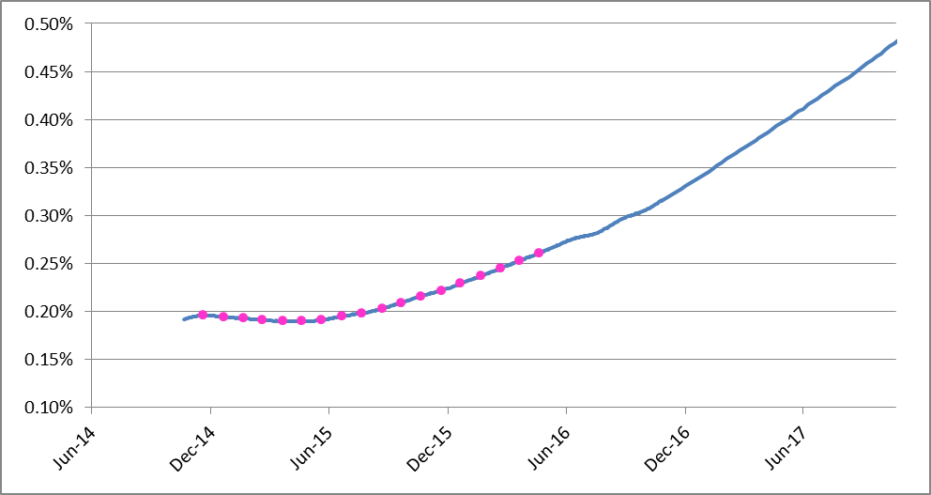
Pseudo-Discount World: EUR6M With Synthetic Deposits Patch

Slide 9
Direct Forward Rate Bootstrapping: the Problem of Non-Smooth Forwards
Direct forward rate bootstrapping gets rid of the synthetic deposit problem, but
Jumps in overnight rates propagate to longer tenor ibor rates, e.g. turns of year
Additive forward rate jumps originating from the same ON jump have different magnitude for different ibor tenors
Increased jump attenuation for longer tenor, subject to convoluted estimation procedures

Slide 10
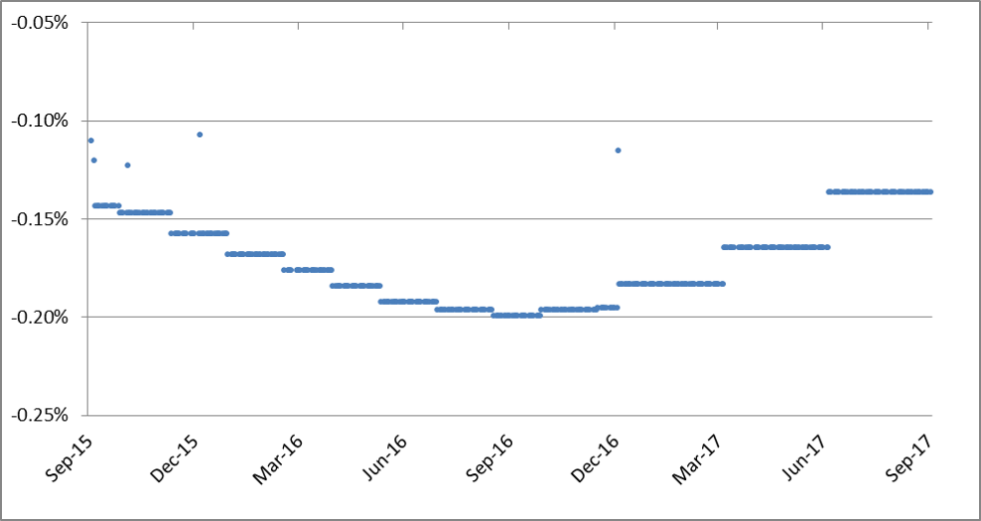
EONIA Turn of Year

Slide 11
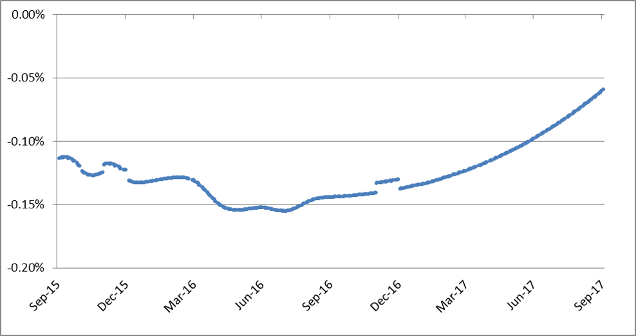
EUR1M Turn of Year

Slide 12
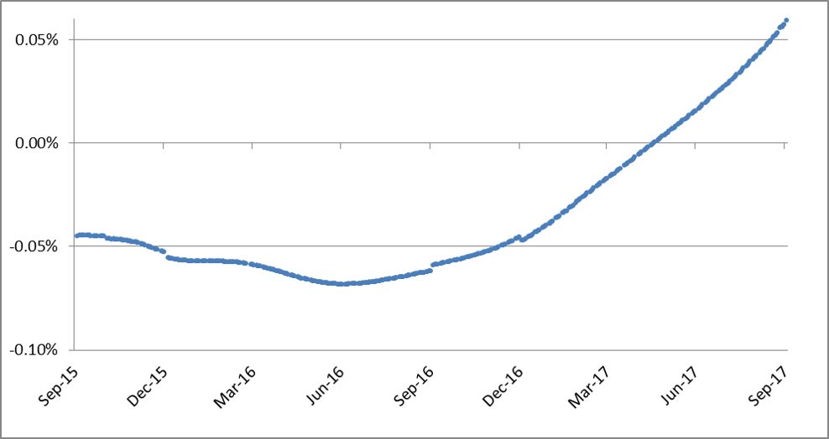
EUR3M Turn of Year

Slide 13
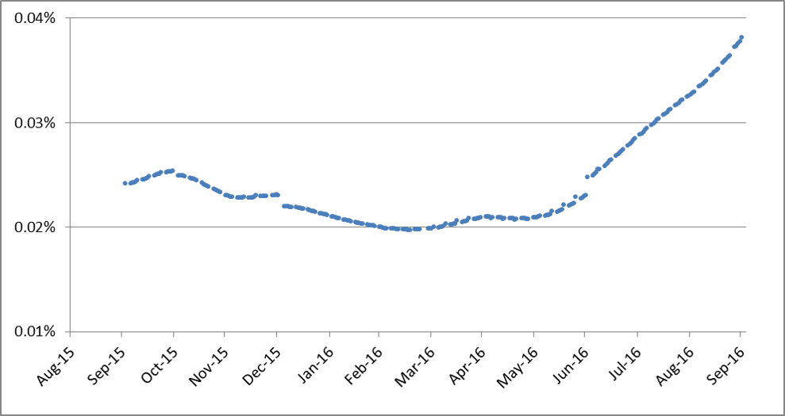
EUR6M Turn of Year

Slide 14
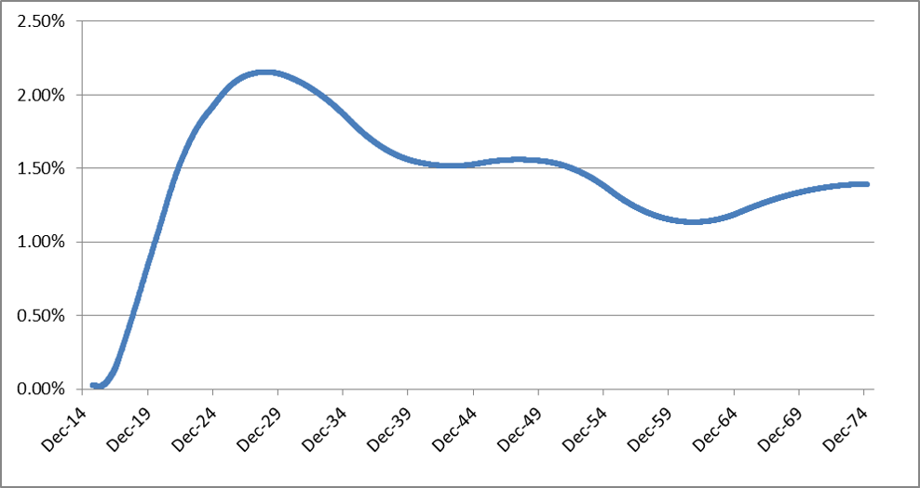
The Legacy (Benchmark) EUR6M Curve
Use OIS for discounting
Never ask a forward curve for discount factors
Notes:
Direct bootstrap of forward would be better

Slide 15
EUR6M/OIS6M Basis
$$S_{6M}\left(t\right)= F_{6M}\left(t\right)− F_{6M}^{ON}\left(t\right)$$
Notes:
1 Bootstrap legacy discount based reference curve
2 blu points are Simple Basis (Fwd 6M – Fwd ON) from reference legacy curve
3 Red curve is ABCD using Forward-based helpers (without K)
Ibor forward rates can be seen as integral of the overnight curve plus a basis. There is no reason for this basis not to be smooth

Slide 16
Table of Contents
Rate Curves: Recent Developments and Current Practice
Relation Between Continuous and Simple Basis
Tenor Dominance
Conclusions
Appendices
Estimation of First Pillar
Derivation of Equivalence Formulas

Slide 17
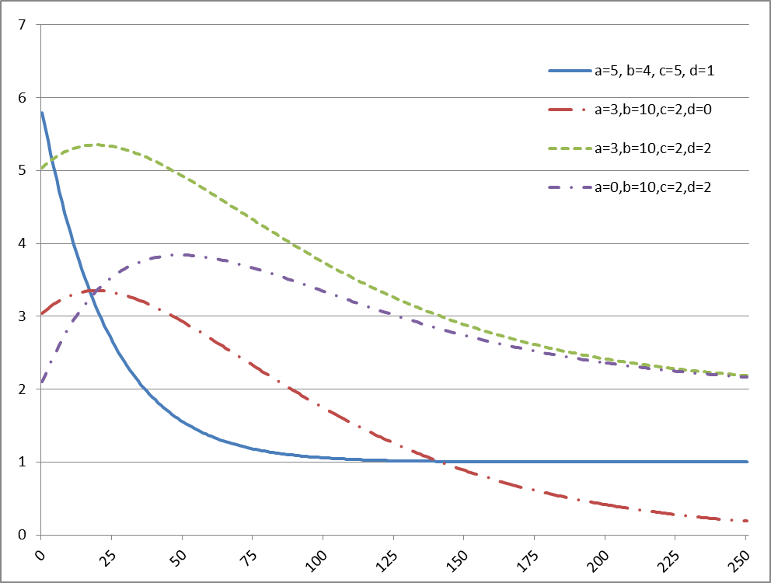


Rebonato’s abcd Parameterization
$$f\left(t\right)=\left(a+bt\right)e^{−ct}+d$$
$a+d$is the value in $t=0$;
$d$ is the long term value;
For a bounded $f(t)$, it must be $c>0$;
The hump max is at:
$$t_{max}= \frac{1}{c} − \frac{a}{b}$$
(relevant only if positive)

Slide 18
EUR6M/OIS6M Simple Basis from ABCD 6M FRA/Swap Calibration
A=0.2038%, B=0.001, C=0.210, D=0.0452%
$$S_{6M}\left(t\right)= F_{6M}\left(t\right)− F_{6M}^{ON}\left(t\right)$$
Notes:
1 Bootstrap legacy discount based reference curve
2 blu points are Simple Basis (Fwd 6M – Fwd ON) from reference legacy curve
3 Red curve is ABCD using Forward-based helpers (without K)
Ibor forward rates can be seen as integral of the overnight curve plus a basis. There is no reason for this basis not to be smooth

Slide 19
Fitting to Market Instrument, Not to the Legacy Benchmark
The legacy benchmark curve is something to be improved upon, displayed as comparison, not something we want to exactly reproduce
The quality of the fit has to be judged by market instruments repricing errors

Slide 20
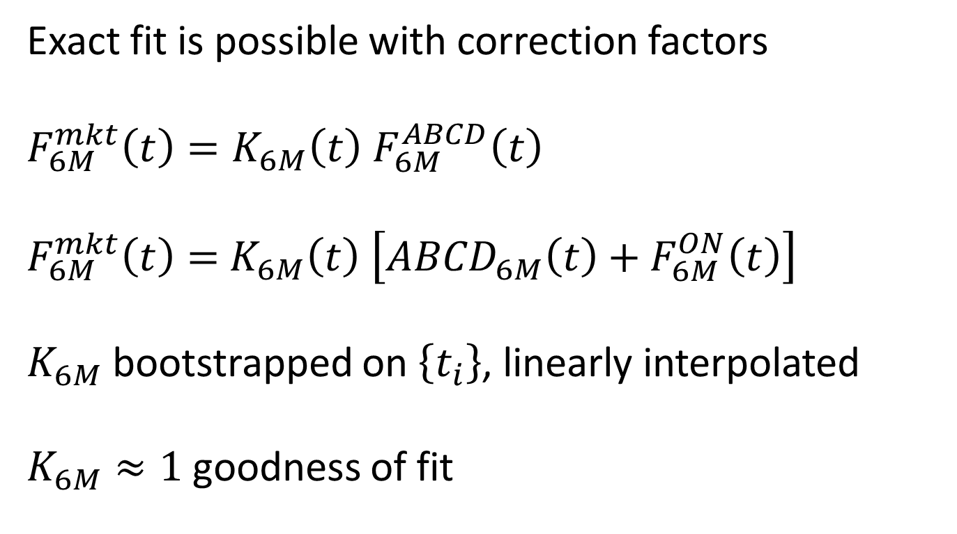
EUR6M from Simple Basis {ABCD + K} Exact-Fit Correction
Exact fit is possible with correction factors
$$F_{6M}^{mkt}\left(t\right)=K_{6M}\left(t\right) F_{6M}^{ABCD}\left(t\right)$$
$F_{6M}^{mkt}\left(t\right)=$ $K_{6M}\left(t\right) \left[{ABCD}_{6M}\left(t\right)+F_{6M}^{ON}\left(t\right)\right]$
$K_{6M}$ bootstrapped on $\left\{t_{i}\right\}$, linearly interpolated
$K_{6M}≈1$ goodness of fit

Slide 21
ABDC curve plus points from ABCD+K curve (fitting just a few selected market instruments)
Notice: all market instruments are repriced, but the forward rates obtained from ABCD+K are different from those obtained from reference legacy curve (table values at blue points’ dates)

Slide 22
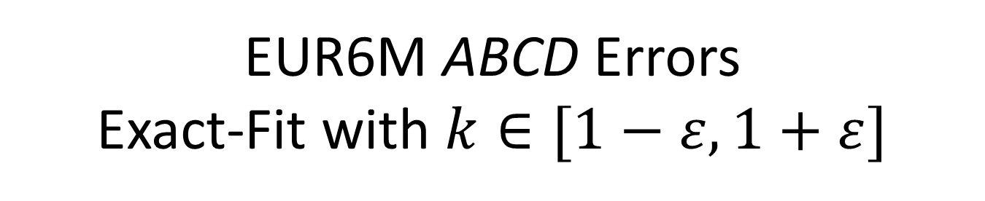
EUR6M ABCD Errors Exact-Fit with $k∈[1−ε,1+ε]$

Slide 23
Table of Contents
Rate Curves: Recent Developments and Current Practice
Relation Between Continuous and Simple Basis
Tenor Dominance
Conclusions
Appendices
Estimation of First Pillar
Derivation of Equivalence Formulas

Slide 24
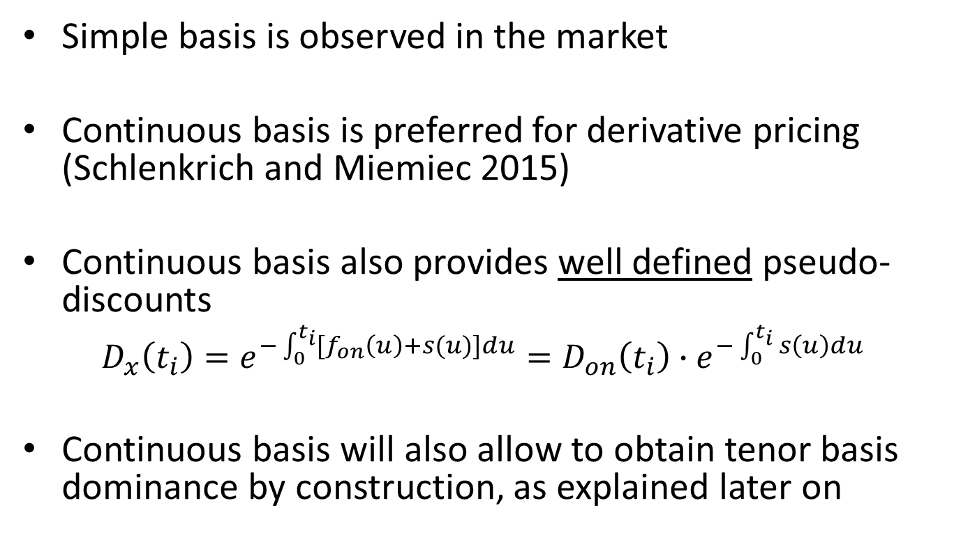
The Case for Continuous Basis
Simple basis is observed in the market
Continuous basis is preferred for derivative pricing (Schlenkrich and Miemiec 2015)
Continuous basis also provides well defined pseudo-discounts
$$D_{x}\left(t_{i}\right)=e^{−\int_{0}^{t_{i}}{{[f}_{on}\left(u\right)+s(u)]du}}=D_{on}\left(t_{i}\right){∙e}^{−\int_{0}^{t_{i}}{s\left(u\right)du}}$$
Continuous basis will also allow to obtain tenor basis dominance by construction, as explained later on

Slide 25
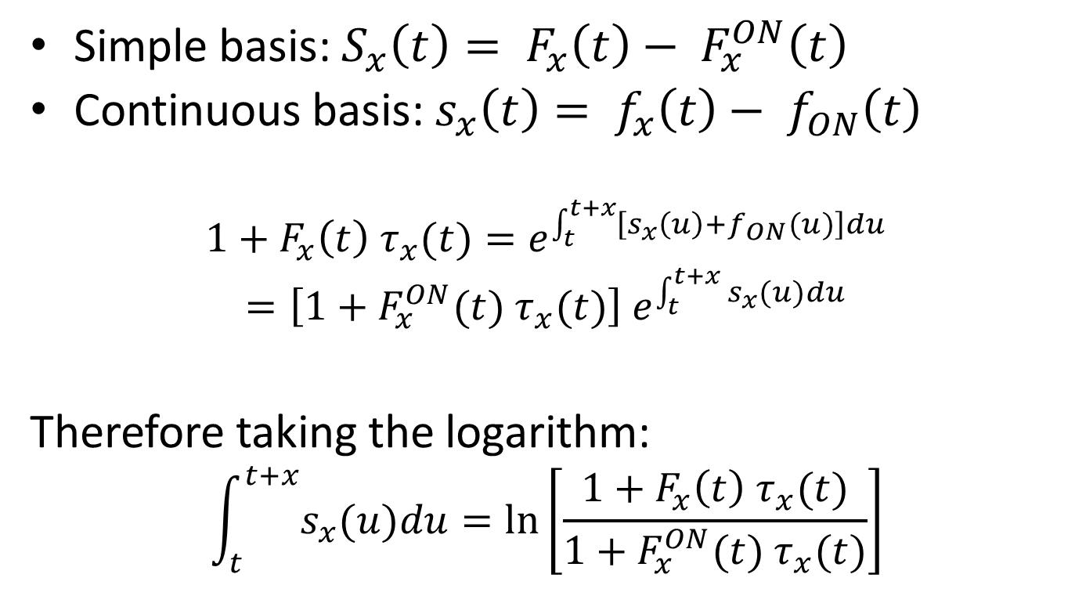
Relation between Simple and Continuous Basis (1/2)
Simple basis: $S_{x}\left(t\right)= F_{x}\left(t\right)− F_{x}^{ON}\left(t\right)$
Continuous basis: $s_{x}\left(t\right)= f_{x}\left(t\right)− f_{ON}\left(t\right)$
$$1+F_{x}\left(t\right){ τ}_{x}(t)=e^{\int_{t}^{t+x}{\left[s_{x}\left(u\right)+f_{ON}(u)\right]du}}$$
$$=\left[1+F_{x}^{ON}(t){ τ}_{x}(t)\right] e^{\int_{t}^{t+x}{s_{x}(u)du}}$$
Therefore taking the logarithm:
$$\int_{t}^{t+x}{s_{x}(u)du}=\ln\left[\frac{1+F_{x}\left(t\right){ τ}_{x}(t)}{1+F_{x}^{ON}(t){ τ}_{x}(t)}\right]$$

Slide 26
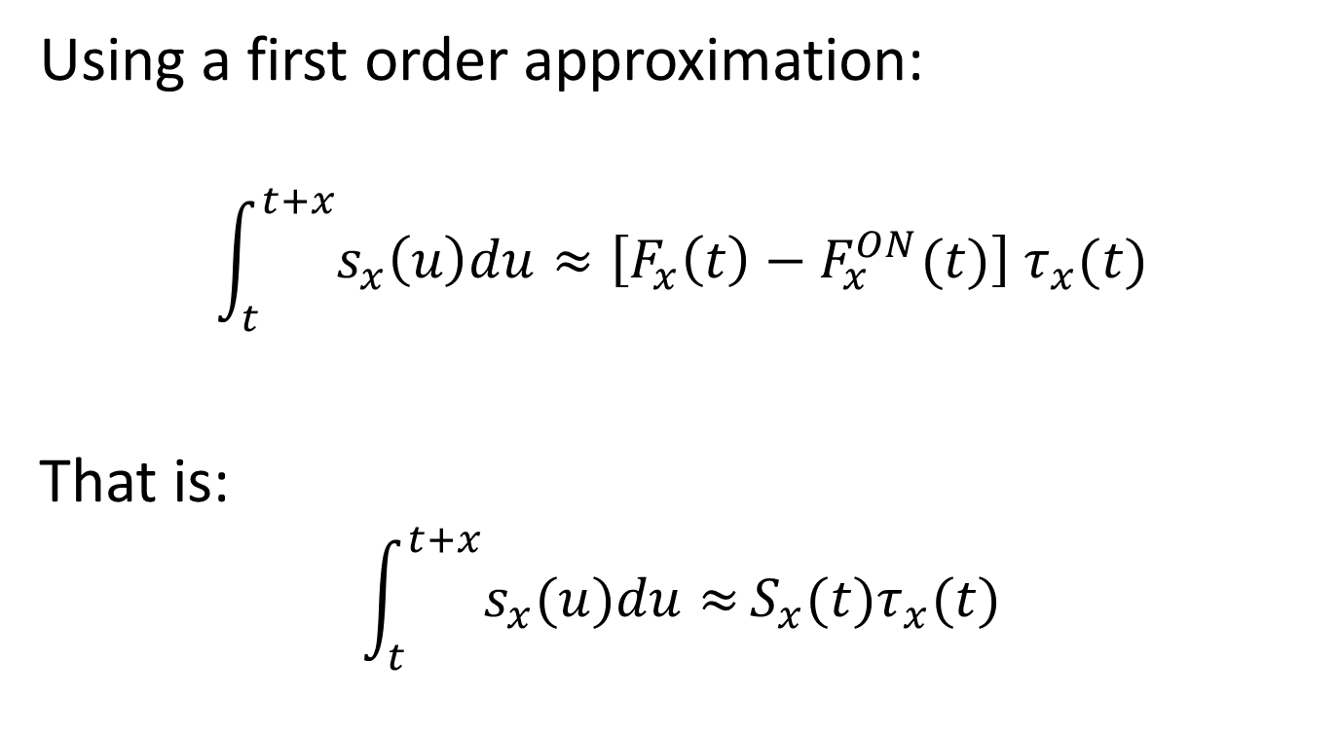
Relation between Simple and Continuous Basis (2/2)
Using a first order approximation:
$$\int_{t}^{t+x}{s_{x}\left(u\right)du}≈\left[F_{x}\left(t\right)−F_{x}^{ON}(t)\right]{ τ}_{x}(t)$$
That is:
$$\int_{t}^{t+x}{s_{x}(u)du≈}S_{x}(t)τ_{x}(t)$$

Slide 27
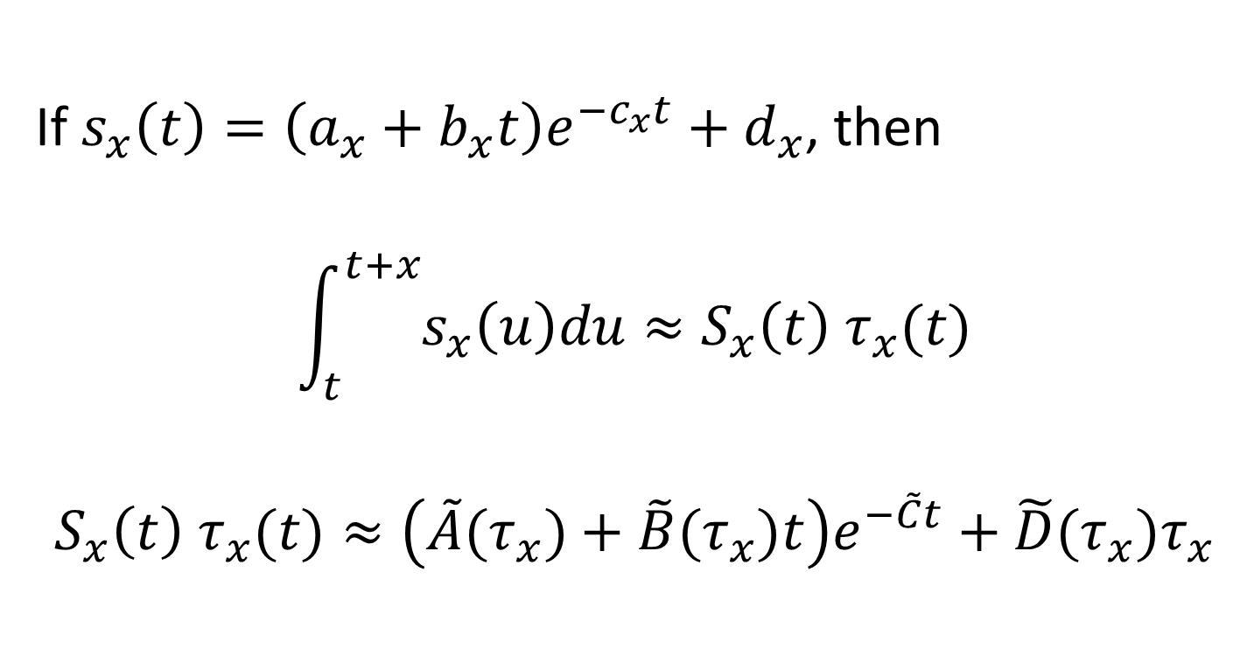
If the Continuous Basis Is abcd, Then the Simple Basis Is ABCD Too (1/2)
If $s_{x}\left(t\right)=\left(a_{x}+b_{x}t\right)e^{−c_{x}t}+d_{x}$, then
$$\int_{t}^{t+x}{s_{x}\left(u\right)du}≈S_{x}\left(t\right){ τ}_{x}(t)$$
$$S_{x}\left(t\right){ τ}_{x}(t)≈\left(\tilde{A}(τ_{x})+\tilde{B}(τ_{x})t\right)e^{−\tilde{C}t}+{\tilde{D}(τ_{x})τ}_{x}$$

Slide 28
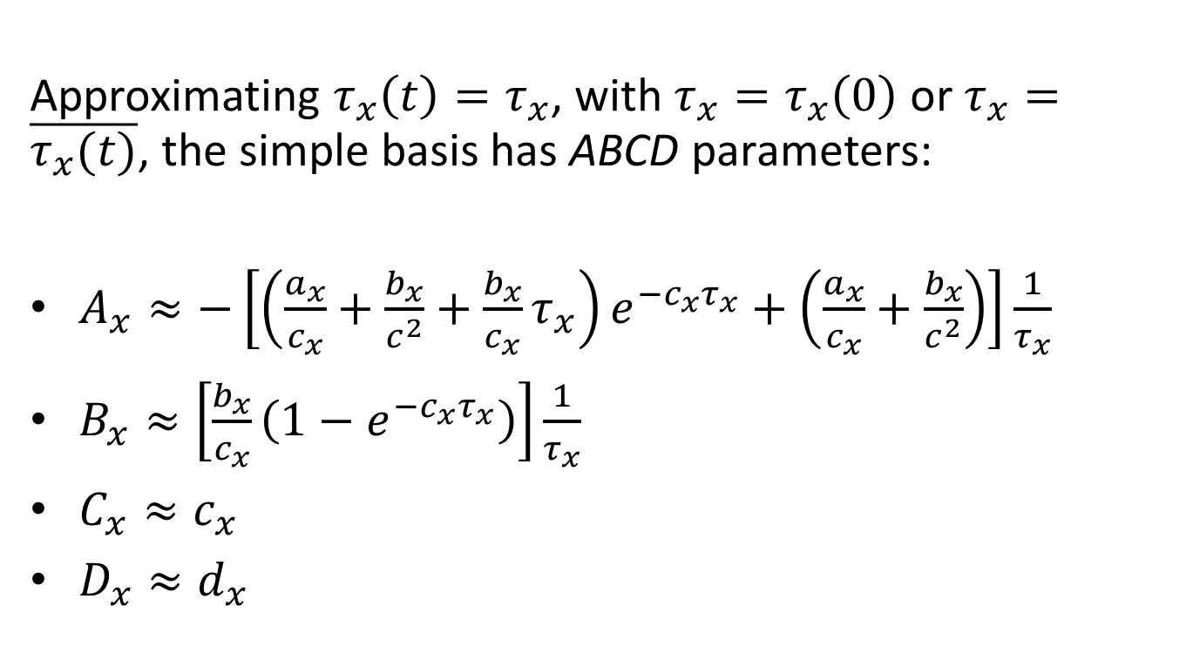
If the Continuous Basis Is abcd, Then the Simple Basis Is ABCD Too (2/2)
Approximating $τ_{x}\left(t\right)=τ_{x}$, with $τ_{x}=τ_{x}\left(0\right)$ or $τ_{x}=\overline{τ_{x}(t)}$, the simple basis has ABCD parameters:
$A_{x}≈−\left[\left(\frac{a_{x}}{c_{x}}+\frac{b_{x}}{c^{2}}+\frac{b_{x}}{c_{x}}τ_{x}\right)e^{−c_{x}τ_{x}}+\left(\frac{a_{x}}{c_{x}}+\frac{b_{x}}{c^{2}}\right)\right]\frac{1}{τ_{x}}$
$B_{x}≈\left[\frac{b_{x}}{c_{x}}\left(1−e^{−c_{x}τ_{x}}\right)\right]\frac{1}{τ_{x}}$
$C_{x}≈c_{x}$
$D_{x}≈d_{x}$

Slide 29
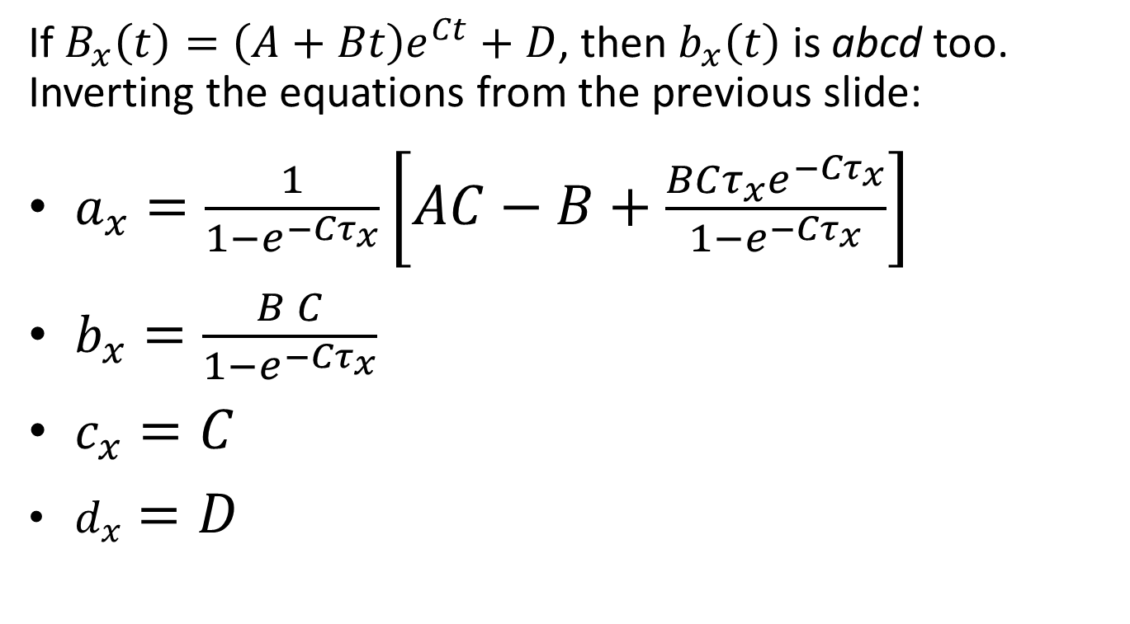
If the Simple Basis Is ABCD, Then the Continuous Basis Is abcd Too
If $B_{x}\left(t\right)=\left(A+Bt\right)e^{Ct}+D$, then $b_{x}\left(t\right)$ is abcd too. Inverting the equations from the previous slide:
$a_{x}=\frac{1}{1−e^{−Cτ_{x}}}\left[AC−B+\frac{BCτ_{x}e^{−Cτ_{x}}}{1−e^{−Cτ_{x}}}\right]$
$b_{x}=\frac{B C}{1−e^{−Cτ_{x}}}$
$c_{x}=C$
$d_{x}=D$

Slide 30
EUR6M/OIS6M from abcd FRA/Swap Calibration
a=0.1930%, b=0.0010, c=0.211, d=0.0458%
Notes:
Integral of abcd, points are Forward rates from reference legacy curve

Slide 31
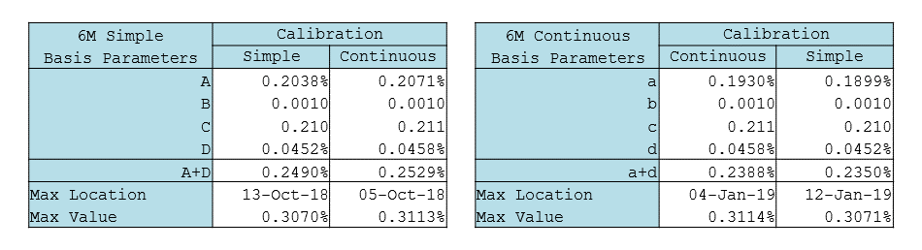
Cross checks

Slide 32
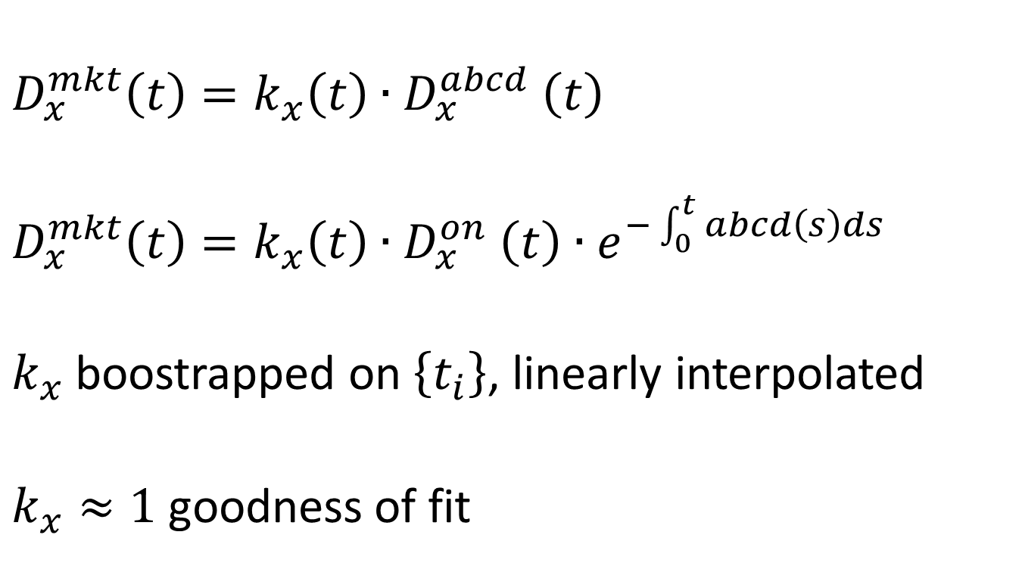
Continuous Basis {abcd + k} Exact-Fit Correction
$$D_{x}^{mkt}\left(t\right)=k_{x}\left(t\right){∙D}_{x}^{abcd}\left(t\right)$$
$$D_{x}^{mkt}\left(t\right)=k_{x}\left(t\right){∙D}_{x}^{on}\left(t\right){∙e}^{−\int_{0}^{t}{abcd\left(s\right)ds}}$$
$k_{x}$ boostrapped on $\left\{t_{i}\right\}$, linearly interpolated
$k_{x}≈1$ goodness of fit

Slide 33
abcd curve vs points from abcd+k curve (fitting just a few selected market instruments)
Notice: all market instruments are repriced, but the forward rates obtained from abcd+k are different from those obtained from reference legacy curve (table values at blue points’ dates)

Slide 34
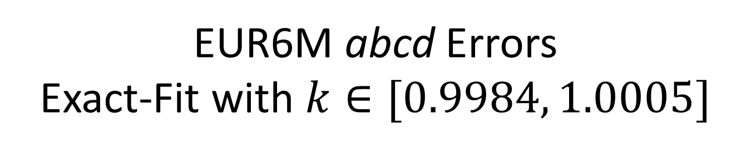
EUR6M abcd Errors Exact-Fit with $k∈[0.9984, 1.0005]$

Slide 35
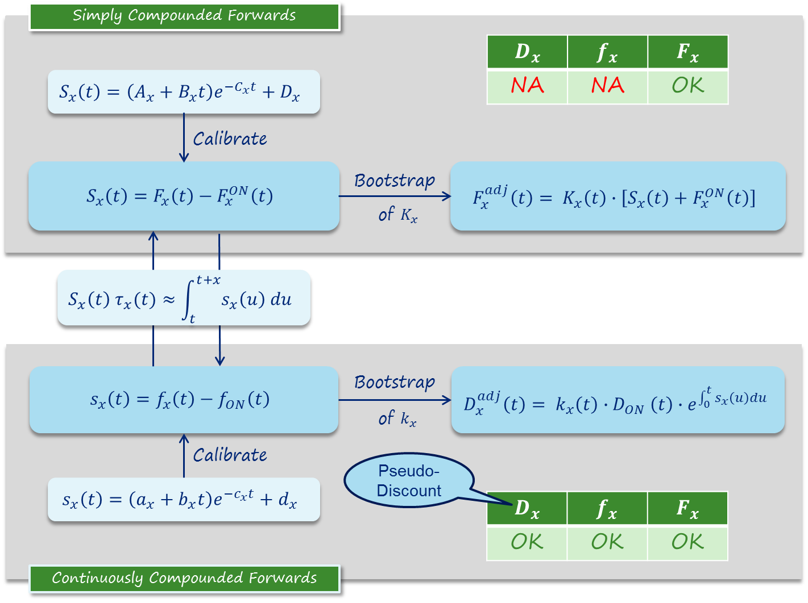

Slide 36
Table of Contents
Rate Curves: Recent Developments and Current Practice
Rationale for ABCD Smooth Basis Modeling
Relation Between Continuous and Simple Basis
Tenor Dominance
Conclusions
Appendices
Estimation of First Pillar
Derivation of Equivalence Formulas

Slide 37
Notes:
Curves are integral of abcd, points are not from legacy reference but must be from abcd+k

Slide 38
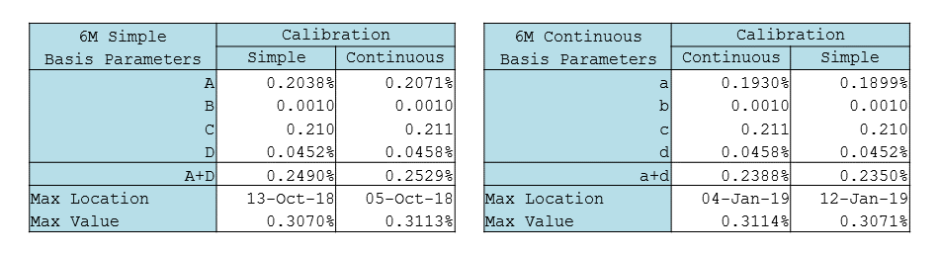
6M Basis
Table: abcd, ABCD(abcd), ABCD

Slide 39
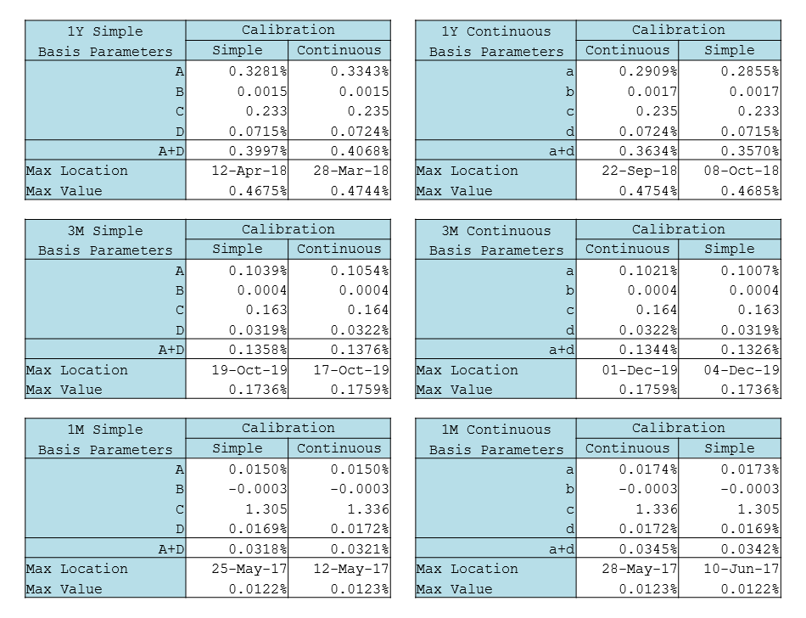
1Y, 3M, 1M

Slide 40
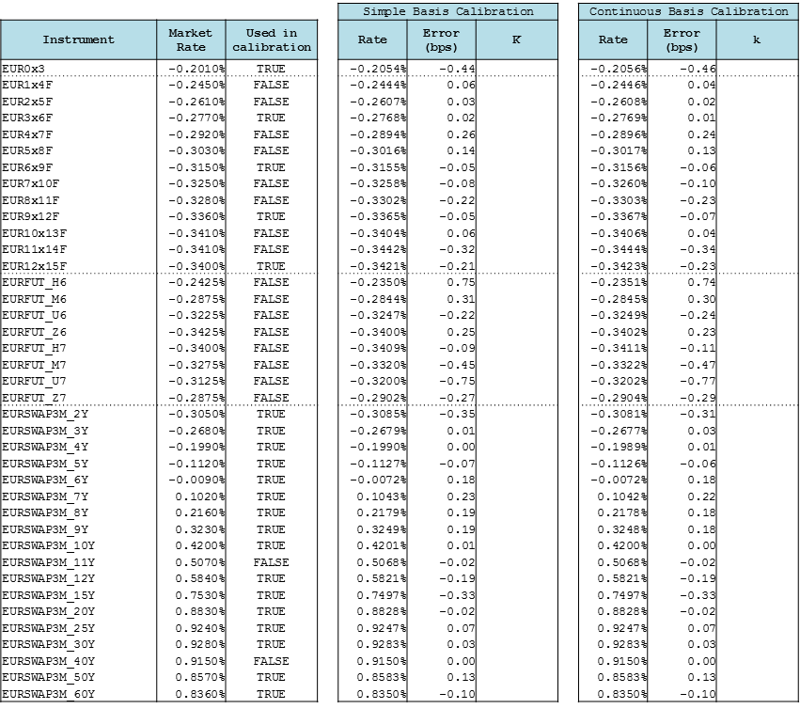
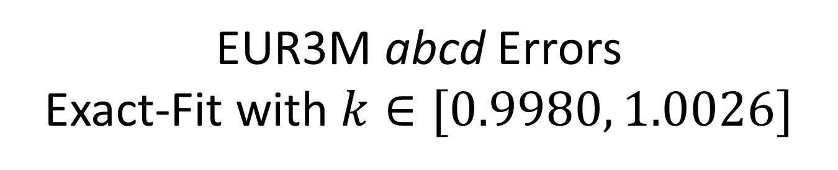
EUR3M abcd Errors Exact-Fit with $k∈[0.9980, 1.0026]$

Slide 41
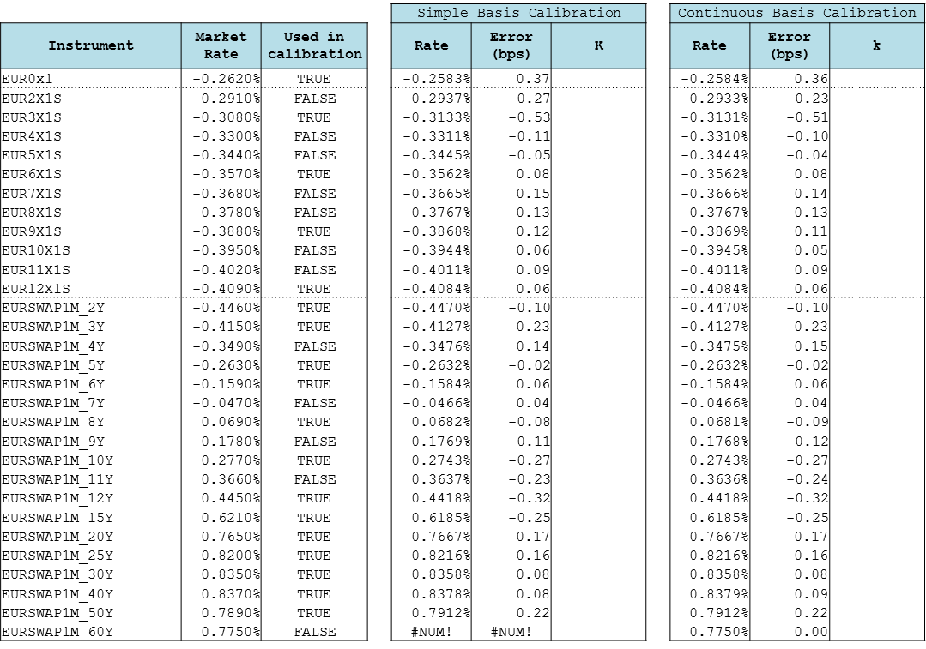
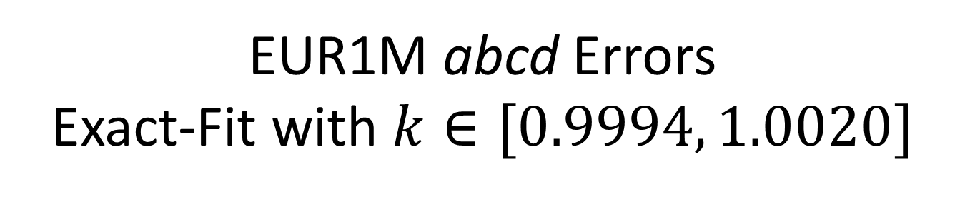
EUR1M abcd Errors Exact-Fit with $k∈[0.9994, 1.0020]$

Slide 42
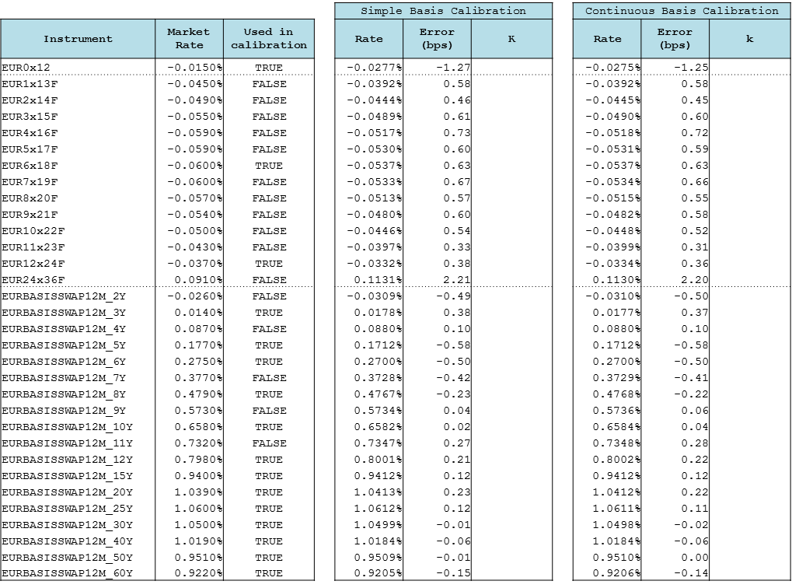
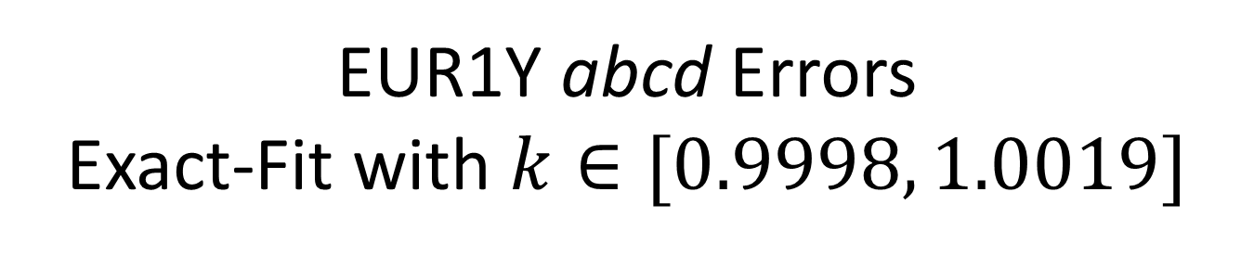
EUR1Y abcd Errors Exact-Fit with $k∈[0.9998, 1.0019]$

Slide 43
Tenor Dominance by construction

Slide 44
Further Research
Other Currencies
Delta weighted (NPV) calibration
Fixed c

Slide 45
Key Points
Forward rates can be modeled as abcd parametric tenor basis spreads over the overnight rate curve
This is possible for both continuously and simply compounded forward rates, with a simple approximation for converting between their basis.
In the case of continuous basis, pseudo-discount factors are also available and can be used for synthetic deposits.
Jumps in forward rates are properly represented: smoothness is moved from the forward to the tenor basis curve.

Slide 46
Table of Contents
Rate Curves: Recent Developments and Current Practice
Rationale for ABCD Smooth Basis Modeling
Relation Between Continuous and Simple Basis
Tenor Dominance
Conclusions
Appendices
Estimation of First Pillar
Derivation of Equivalence Formulas

Slide 47
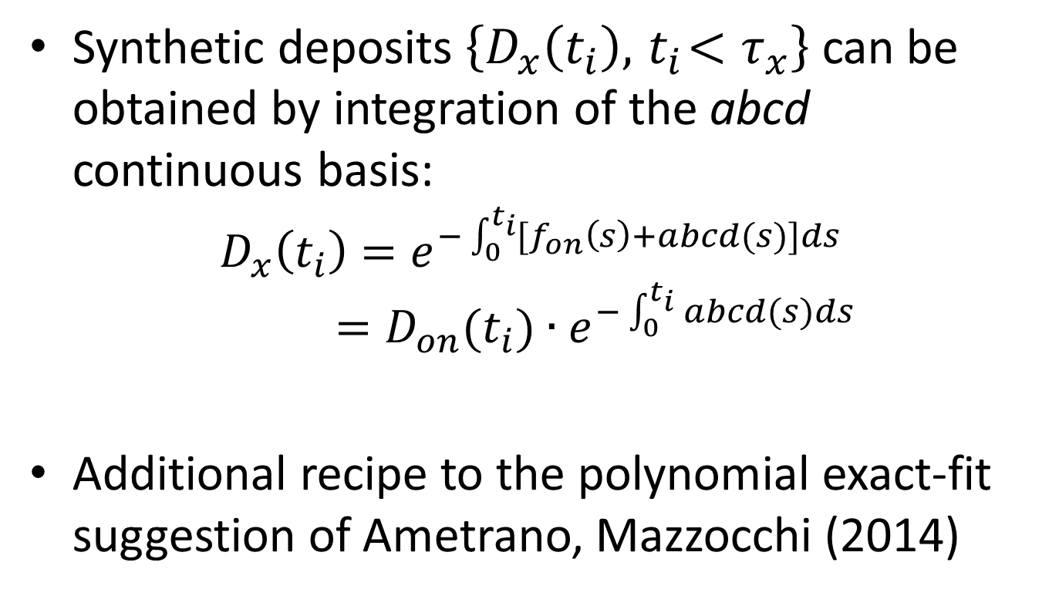
Synthetic Deposits: Back to the abcd Future
Synthetic deposits $\left\{D_{x}\left(t_{i}\right), { t}_{i}<τ_{x}\right\}$ can be obtained by integration of the abcd continuous basis:
$$D_{x}\left(t_{i}\right)=e^{−\int_{0}^{t_{i}}{{[f}_{on}\left(s\right)+abcd(s)]ds}}=D_{on}(t_{i}){∙e}^{−\int_{0}^{t_{i}}{abcd(s)ds}}$$
Additional recipe to the polynomial exact-fit suggestion of Ametrano, Mazzocchi (2014)

Slide 48
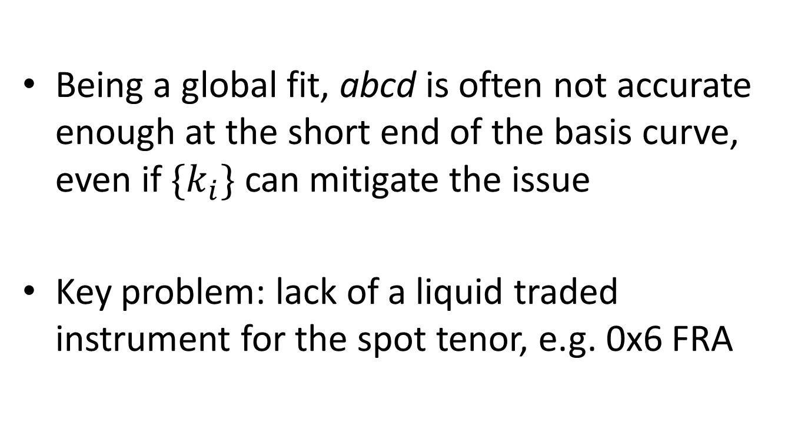
Synthetic Deposits: The abcd Limit
Being a global fit, abcd is often not accurate enough at the short end of the basis curve, even if $\{k_{i}\}$ can mitigate the issue
Key problem: lack of a liquid traded instrument for the spot tenor, e.g. 0x6 FRA

Slide 49
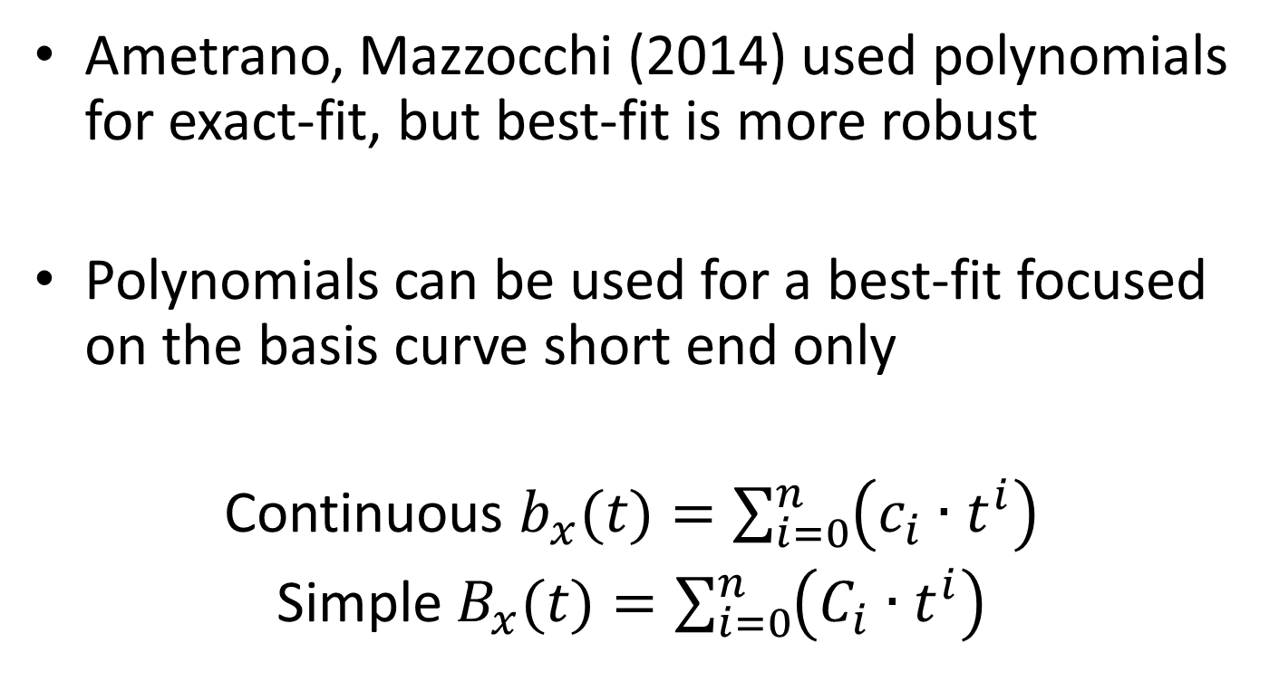
Polynomial Basis Parameterization at the Short End of the Curve
Ametrano, Mazzocchi (2014) used polynomials for exact-fit, but best-fit is more robust
Polynomials can be used for a best-fit focused on the basis curve short end only
Continuous $b_{x}(t)=\sum_{i=0}^{n}{\left(c_{i}∙t^{i}\right)}$
Simple $B_{x}(t)=\sum_{i=0}^{n}{\left(C_{i}∙t^{i}\right)}$

Slide 50
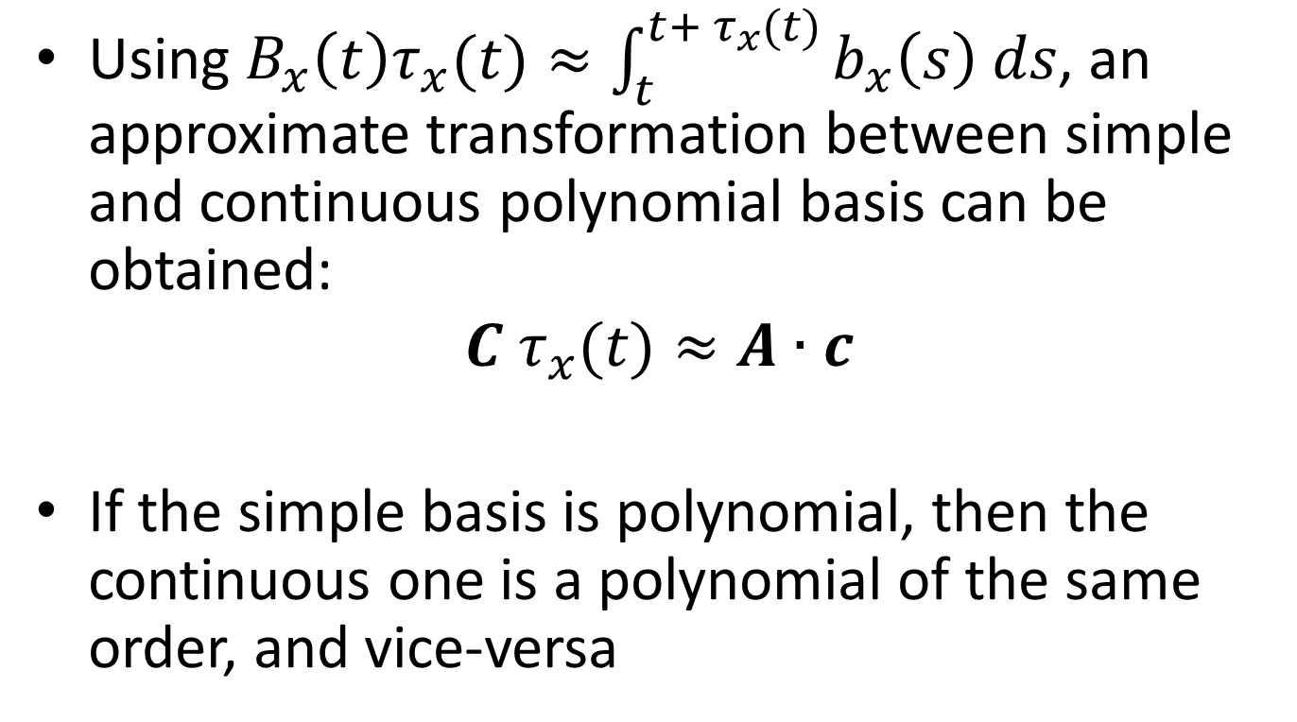
Polynomial Basis Parameterization
Using $B_{x}\left(t\right)τ_{x}(t)≈\int_{t}^{t+{ τ}_{x}(t)}{b_{x}\left(s\right) ds}$, an approximate transformation between simple and continuous polynomial basis can be obtained:
$$C{ τ}_{x}(t)≈A∙c$$
If the simple basis is polynomial, then the continuous one is a polynomial of the same order, and vice-versa

Slide 51
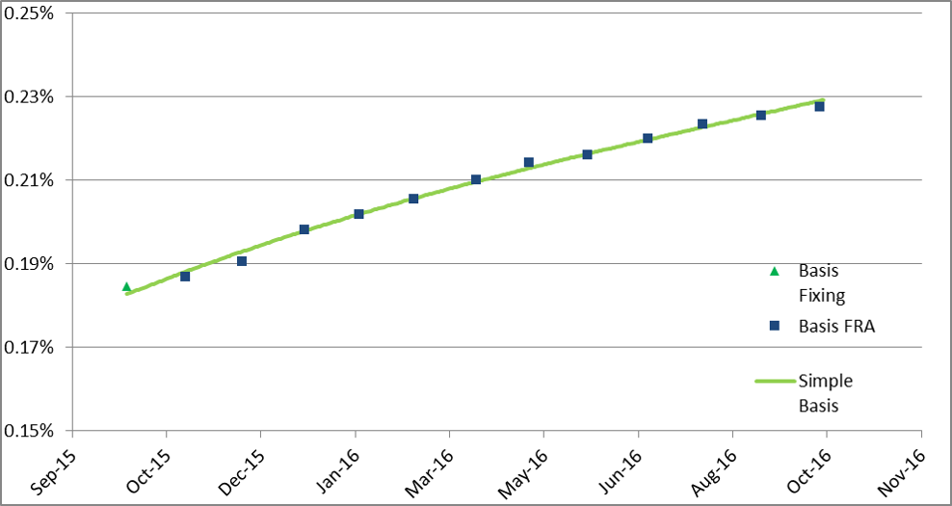
Polynomial Best-fit of the Simple Basis
Best-fit is robust to left extrapolation, e.g. 0x6 FRA

Slide 52
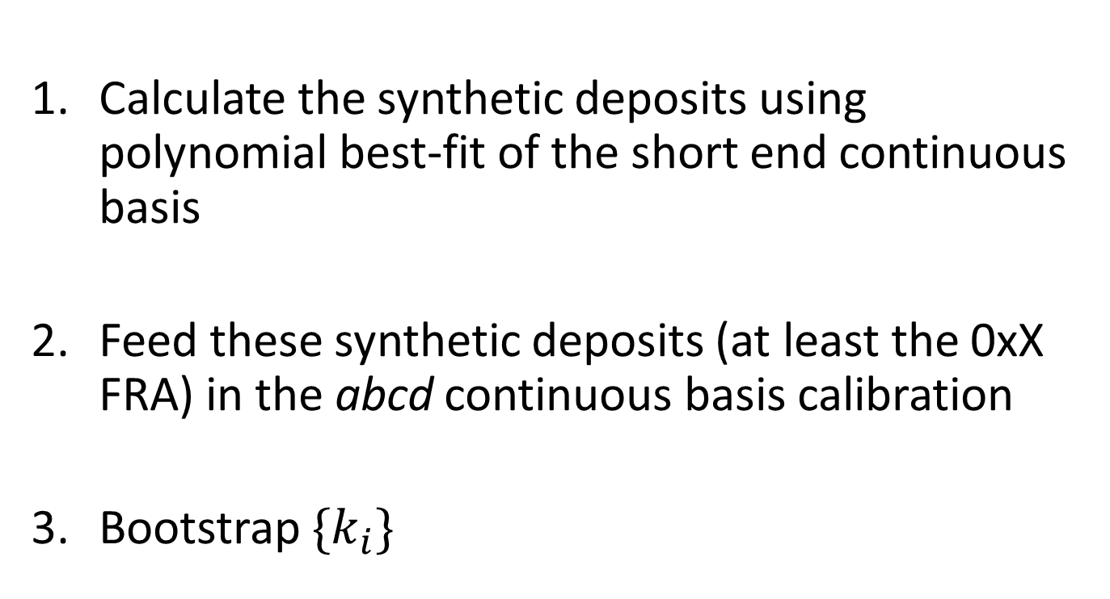
Divide, Itera, et Impera: Polynomials Synthetic Deposits in abcd Calibration
Calculate the synthetic deposits using polynomial best-fit of the short end continuous basis
Feed these synthetic deposits (at least the 0xX FRA) in the abcd continuous basis calibration
Bootstrap $\{k_{i}\}$

Slide 53
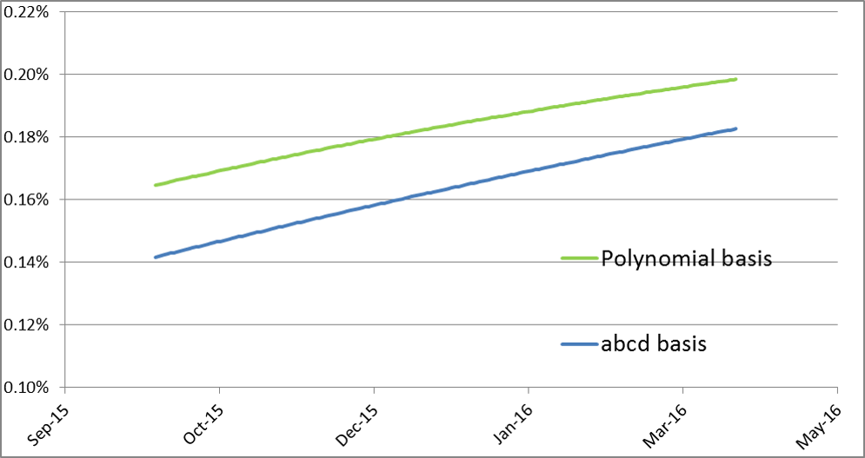
abcd Continuous Basis The Short End of the Curve
The integral over the first 6M is not accurate

Slide 54
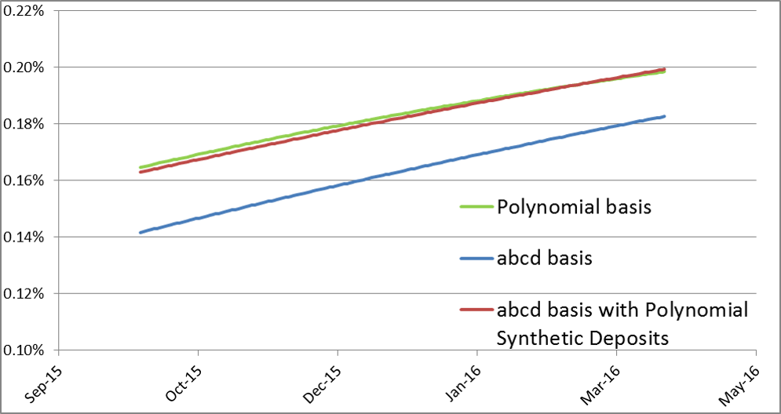
abcd Continuous Basis On Polynomials Steroids
The integral over the first 6M is now accurate!

Slide 55
Bibliography
Working Paper: http://ssrn.com/abstract=2696743
GitHub: https://github.com/paolomazzocchi/abcd_basis_spreads
Slides https://speakerdeck.com/nando1970/the-abcd-of-interest-rate-basis-spreads

Slide 56
Bibliography
F. Ametrano, P. Mazzocchi. Eonia Jumps and Proper Euribor Forwarding (2014). https://speakerdeck.com/nando1970/eonia-jumps-and-proper-euribor-forwarding
F. Ametrano, M. Bianchetti. Everything You Always Wanted to Know About Multiple Interest Rate Curve Bootstrapping but Were Afraid to Ask (2013). http://ssrn.com/abstract=2219548
M. Henrard. Interest Rate Modelling in the Multi-Curve Framework (Palgrave Macmillian 2014)
R. Rebonato. Volatility and Correlation (Wiley 2004)
S. Schlenkrich, A. Miemiec. Choosing the Right Spread (Wilmott 2015). http://ssrn.com/abstract=2400911
QuantLib GitHub branch: https://github.com/paolomazzocchi/quantlib/tree/tenorbasis

